Slide 1
UNIT III

Slide 2
UNIT - iii
Mule Application Structure
Use Application Properties Identify Mule Project File and Folder Purposes
Web Services
Consume Web Services in Anypoint Exchange Using APIs and Connectors, Consume RESTful Web Services, Consume SOAP Web Services.
Event Flow
Examine Multicast Events, Route Events Based on Conditions, Validate Events.

Slide 3
Mule Application Structure
A Mule application's structure is typically organized to facilitate development, deployment, and maintainability. Key components and their roles are as follows:
Key Components
Flows (.xml files): Core logic of the Mule application.
Properties: Externalize configuration (environment-specific values).
mule-artifact.json: Declares application metadata.
pom.xml: Required if the project is managed with Maven (helps in CI/CD pipelines).
API folder: Used for RAML/APIkit if your app exposes or implements APIs.

Slide 4
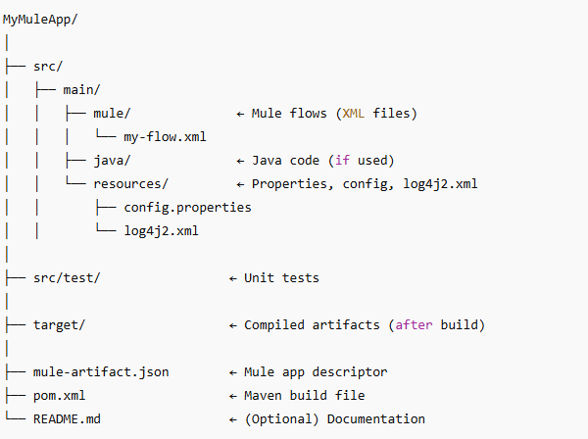
A typical Mule application structure in Anypoint Studio follows a specific folder layout

Slide 5
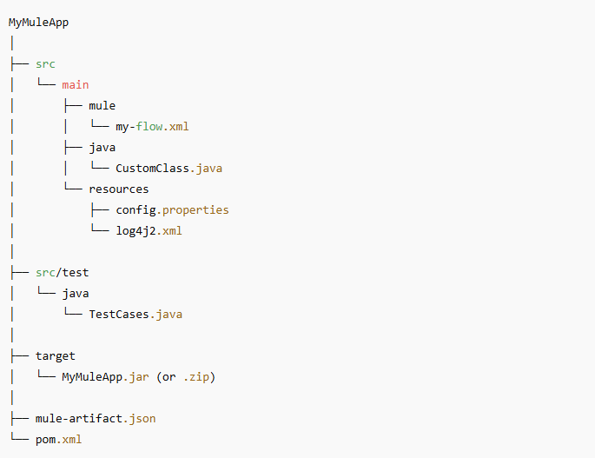
Here’s a simple figure to visualize the structure:

Slide 6
Consume RESTful Web Services
To consume data from a REST API from within a Mule application, you can configure Anypoint Connector for HTTP Request (HTTP Request Connector).

Slide 7
Consume RESTful Web Services
The following example illustrates how to configure Anypoint Connector for HTTP (HTTP Connector) to consume a REST service by setting up the HTTP Listener source and the Request operation.
To accomplish this example, you must:
Consume a REST API service using default HTTP configurations.
Test the HTTP request.
Edit the configuration to make secure HTTPS requests.
Test the HTTPS request.
The following screenshot shows the Anypoint Studio app flow for this example:

Slide 8
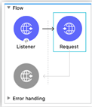
Consume RESTful Web Services
Create the Mule Application
To create the Mule flow:
In the Mule Palette view, select the HTTP Listener source and drag it on to the canvas. The source initiates the flow by listening for incoming HTTP message.
On the Listener configuration screen, optionally change the value of the Display Name field.
Set Path to /trigger.
Click the plus sign (+) next to the Connector configuration field to configure a global element that can be used by all instances of the HTTP Listener in the app.
On the General tab, configure the following fields:
Host: All Interfaces [0.0.0.0] (default)
Port: 8081
Click OK.

Slide 9
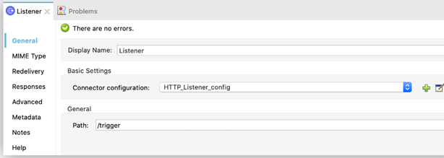
Consume RESTful Web Services

Slide 10
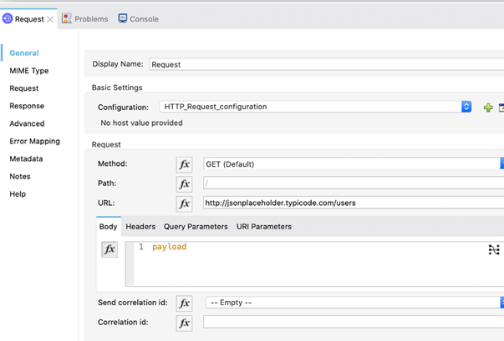
Consume RESTful Web Services

Slide 11
Flows
Mule apps process messages and other parts of Mule events through Mule components, connectors, and modules that are set up within the scope of Flow and Subflow components within an app.
An app can consist of a single flow, or it can break up processing into discrete flows and subflows that you add to the app and connect together.
Mule apps in production environments typically use multiple flows and subflows to divide the app into functional modules or for error handling purposes.
For example, one flow might receive a record and transform data into a given format that another flow processes in some special way.

Slide 12
different type of flows in Mule?
In Mule, there are three main types of flows: Subflows, Synchronous Flows, and Asynchronous Flows. Each type serves a specific purpose in message processing. Here's an explanation with examples:
Subflows
Subflows are used to group common logic and are processed synchronously.
This means that the execution of the calling flow halts until the subflow is complete.
Subflows inherit the processing and exception handling strategies of the calling flow.
They are ideal for reusing code across different parts of an application without needing separate exception handling.
Execution of the calling flow pauses until the subflow completes.
Example:
<sub-flow name="LogSubFlow">
<logger message="Logging data..." level="INFO"/>
</sub-flow>
<flow name="MainFlow">
<flow-ref name="LogSubFlow"/>
</flow>
Here, the LogSubFlow is called from the MainFlow using a flow-ref.

Slide 13
different type of flows in Mule?
Synchronous Flows
Synchronous Flows are also processed synchronously, but unlike subflows, they do not inherit the processing and exception handling strategies of the calling flow.
This makes them suitable for transactional processing where messages need to be processed on a single thread.
Synchronous flows are added to a Mule application as regular flows and are called using a flow reference component.
The parent flow waits for the synchronous flow to complete before resuming.
Example:
<flow name="SynchronousFlow">
<logger message="Processing synchronously..." level="INFO"/>
</flow>
<flow name="ParentFlow">
<flow-ref name="SynchronousFlow"/>
</flow>
The SynchronousFlow is invoked using a flow-ref, and the parent flow waits for it to complete.

Slide 14
different type of flows in Mule?
Asynchronous Flows
Asynchronous Flows execute in parallel to the calling flow, meaning they are processed asynchronously.
They do not inherit the processing and exception handling strategies of the calling flow.
Asynchronous flows are ideal for time-consuming tasks such as sending emails or performing I/O operations.
They are added to the Mule application in the same way as synchronous flows but are called from within an asynchronous scope
Example:
<flow name="AsyncFlow" processingStrategy="async">
<logger message="Processing asynchronously..." level="INFO"/>
</flow>
<flow name="ParentFlow">
<flow-ref name="AsyncFlow"/>
</flow>
Here, the AsyncFlow is configured with the processingStrategy="async" attribute, enabling asynchronous execution.

Slide 15
different type of flows in Mule?
Private Flows
Private Flows are similar to standard flows but without a message source.
They have their own exception handling and create a new execution context. This means that exceptions in private flows are handled locally and do not propagate to the main flow.
Private flows are recommended when separate exception handling is needed or when implementing an asynchronous pattern
Example:
<flow name="privateFlow" processingStrategy="synchronous">
<!-- Flow components here -->
</flow>

Slide 16
validation
The Validation module verifies that the content of a message in a Mule flow matches specific criteria. If a message does not meet the defined validation criteria, the validation fails and returns a validation error, such as VALIDATION:INVALID_URL, which is a ValidationException. Based on the specific data you are validating, you can customize the exception message that is displayed in the logs.

Slide 17
Configure the Is Not Null Operation
The Is not null operation validates that the given value is not null.
The following example shows how to configure the operation in Anypoint Studio:
In the Mule Palette view, select Validation > Is not null.
Drag Is not null onto the Studio canvas.
In the Is not null configuration screen, provide the following parameters:
Value: payload
Message: Null is not a valid value.

Slide 18
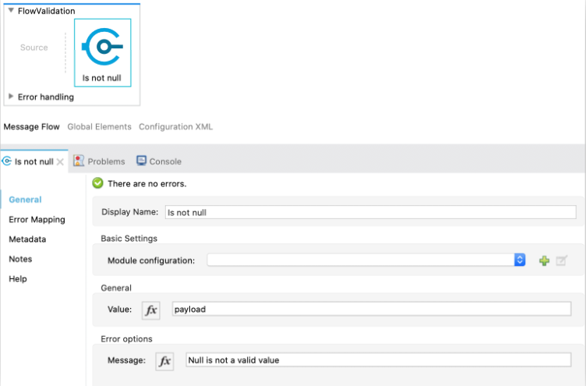
Configure the Is Not Null Operation
Figure - Is not null Configuration
In the Configuration XML editor, the configuration looks like this:
<validation:is-not-null value="#[payload]" message="Null is not a valid value"/>

Slide 19
Configure the Is Number Operation
The Is number operation verifies that a string can be parsed as a number of a specified numeric type, using the given locale (which defaults to the system locale) and pattern (which defaults to the locale pattern). This validation can include a range in which the number is validated using the Min value and Max Value parameters.
The following example shows how to configure the operation in Anypoint Studio:
In the Mule Palette view, select Validation > Is number.
Drag Is number onto the Studio canvas.
In the Is number configuration screen, provide the following parameters:
Value: payload
Locale: US
Min value: vars.minValue
Max value: vars.maxValue
Number type: INTEGER

Slide 20
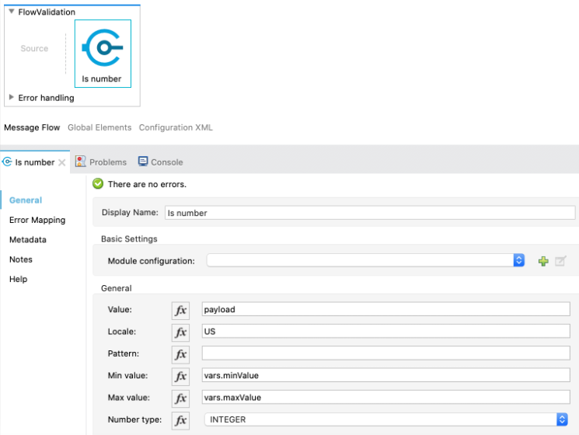
Configure the Is Number Operation
Figure - Is number Configuration
In the Configuration XML editor, the configuration looks like this:
<validation:is-number value="#[payload]" minValue="#[vars.minValue]" maxValue="#[vars.maxValue]" numberType="INTEGER" locale="US"/>

Slide 21
Configure the Is Email Operation
The Is email operation checks that a given email is valid. The value defaults to the email payload.
The following example shows how to configure the operation in Anypoint Studio:
In the Mule Palette view, select Validation > Is email.
Drag Is email onto the Studio canvas.
In the Is email configuration screen, provide the following parameters:
Email: vars.email
Message: The value is not a valid email.

Slide 22
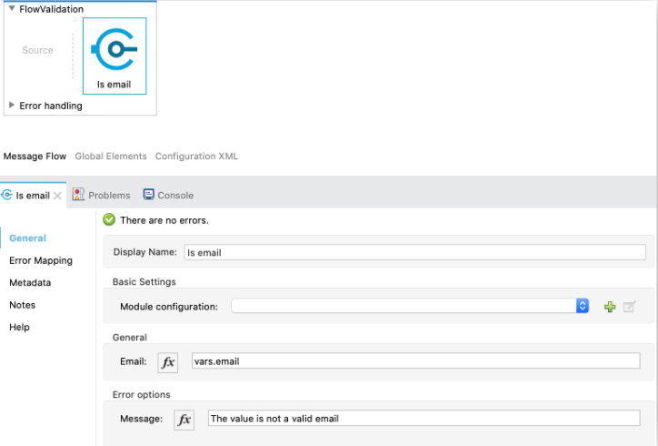
Configure the Is Email Operation
Figure - Is email Configuration
In the Configuration XML editor, the configuration looks like this:
<validation:is-email email="#[vars.email]" message="The value is not a valid email"/>

Slide 23
Choice router
Choice Router | MuleSoft Documentation
Consume Data from an API | MuleSoft Documentation

